Slide 1

Internship Recap 2023
Hadi Baajour

Slide 2

About Myself
B.S. Computer Science
University of Florida
Incoming Senior

Slide 3
Summer Intern Work Summary
Jira Automated Help Desk Password Reset Feature
Field Behavior Script for CEC ID
CATC CEC/Engineering Lead Lookup Listener Update
XSRF Token for PTT Notification Webhook
Change Status Reason Prediction Model

Slide 4
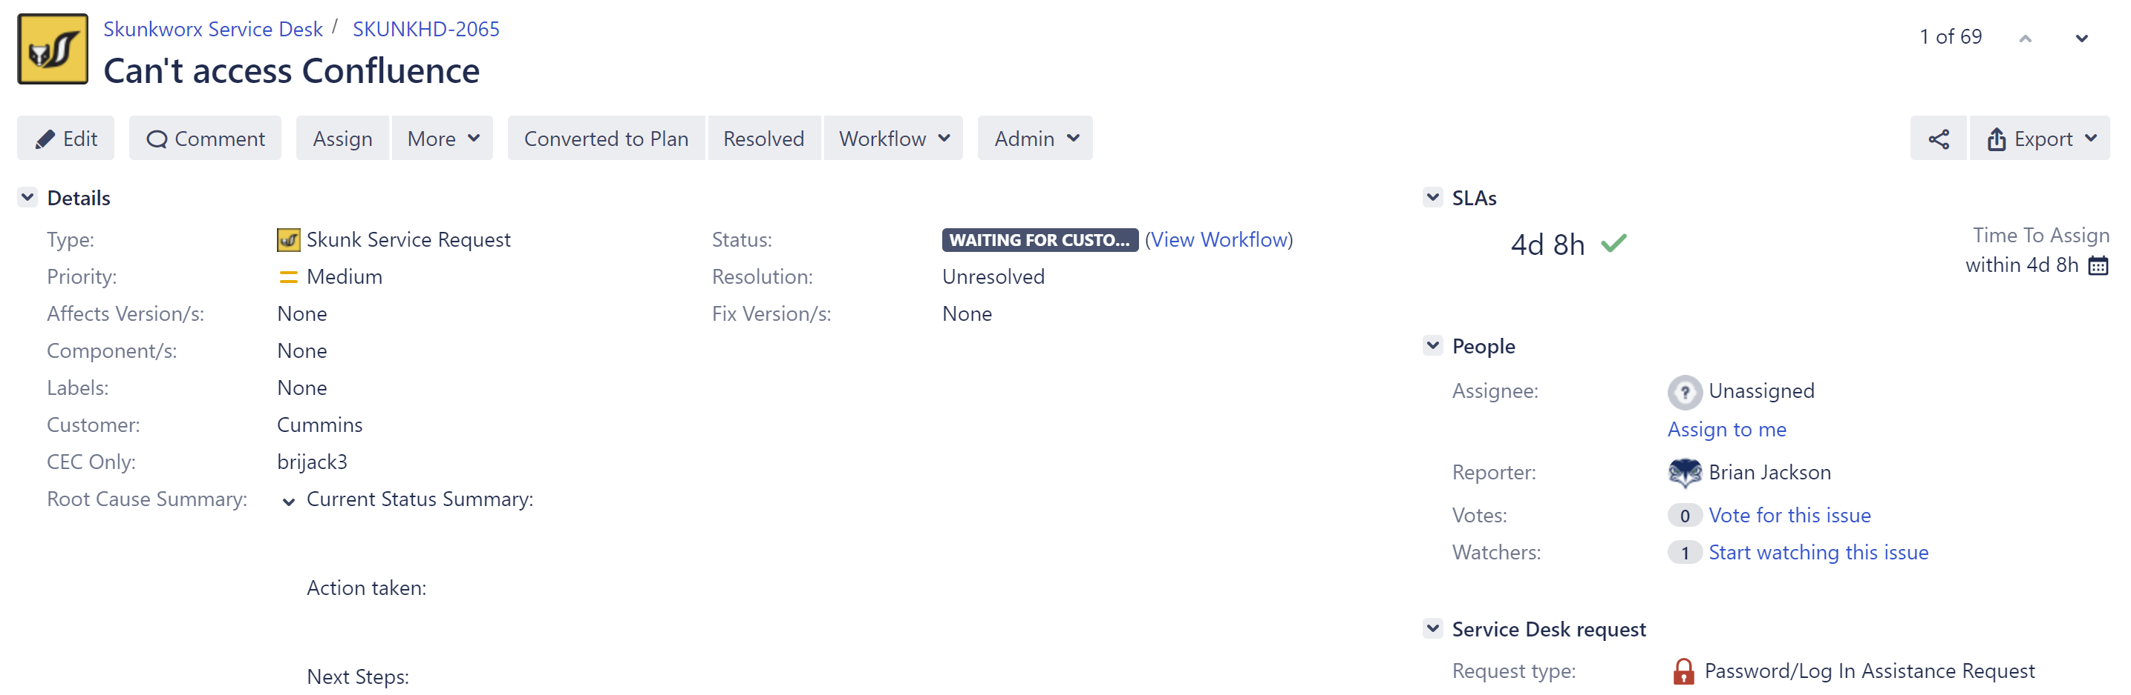

Jira Automated Help Desk Password Reset Feature
Problem Statement: Create automation to confirm that the password reset was successful and if so close the request in the service desk
Three areas where a CEC ID can be found; eventually focused on CEC Only field
Script helped in automating the task of manually closing/resolving each ticket after a user changes their password

Slide 5
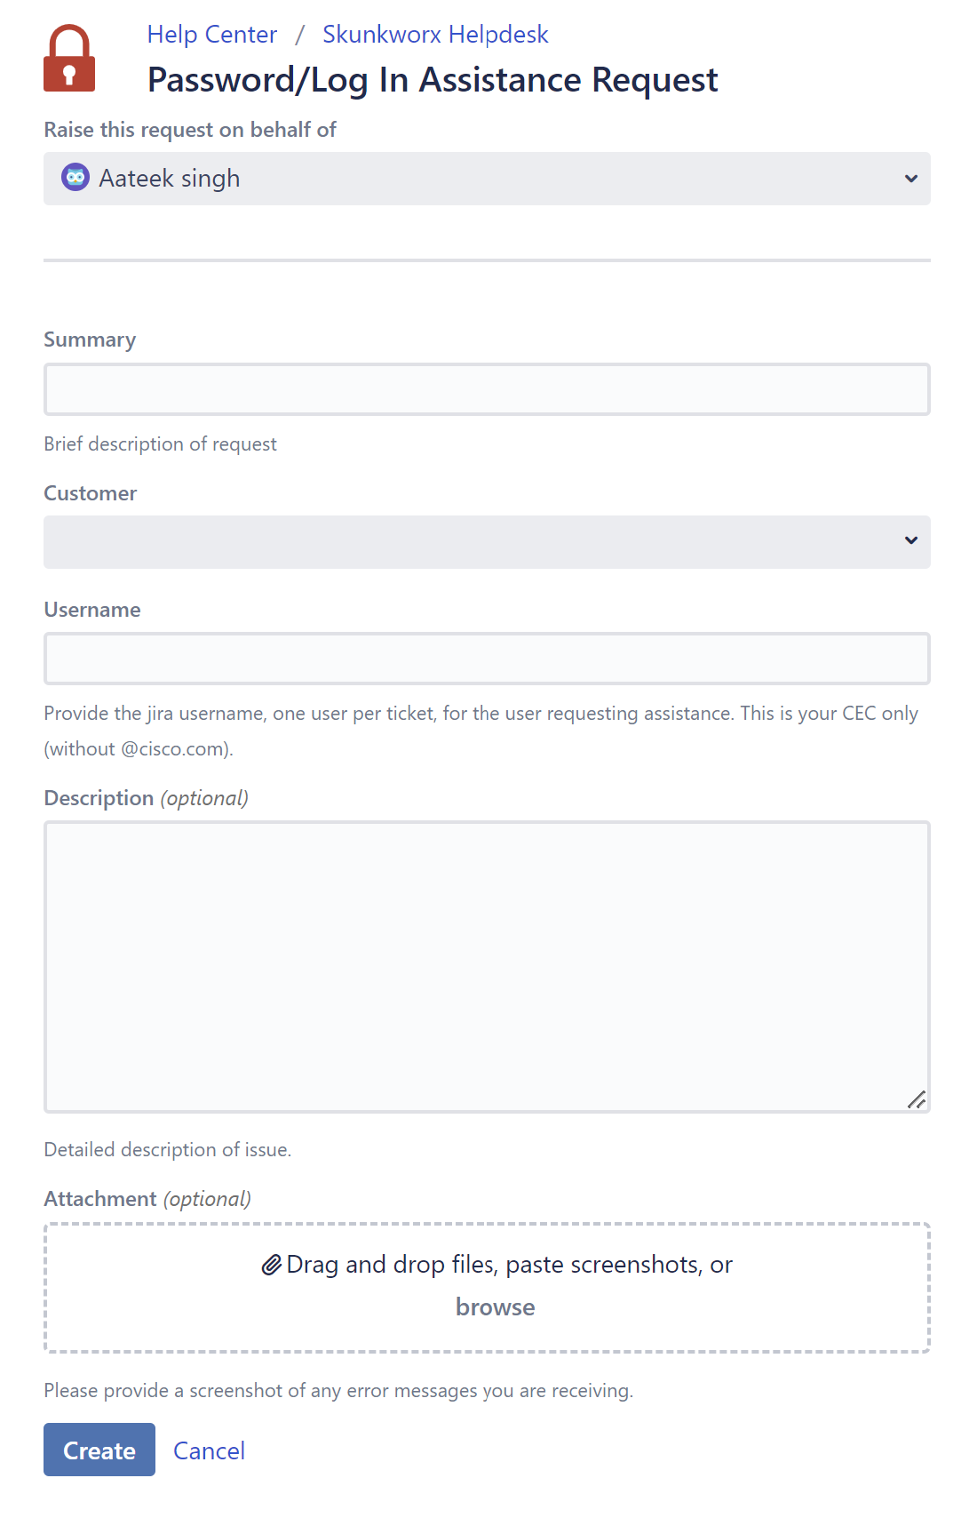
Field Behavior Script for CEC ID
Problem Statement: Script runner behavior needed to limit the user input for the CEC ID field on the service desk
The idea is to essentially extract everything written within the CEC ID field and use RegEx to evaluate whether the field was filled in properly (No special characters or spaces)
Saves time having to manually check each CEC ID to make sure they are actually in the system

Slide 6
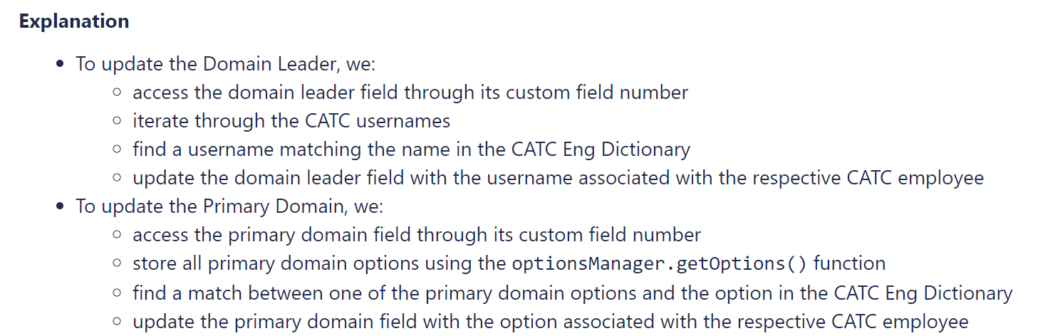
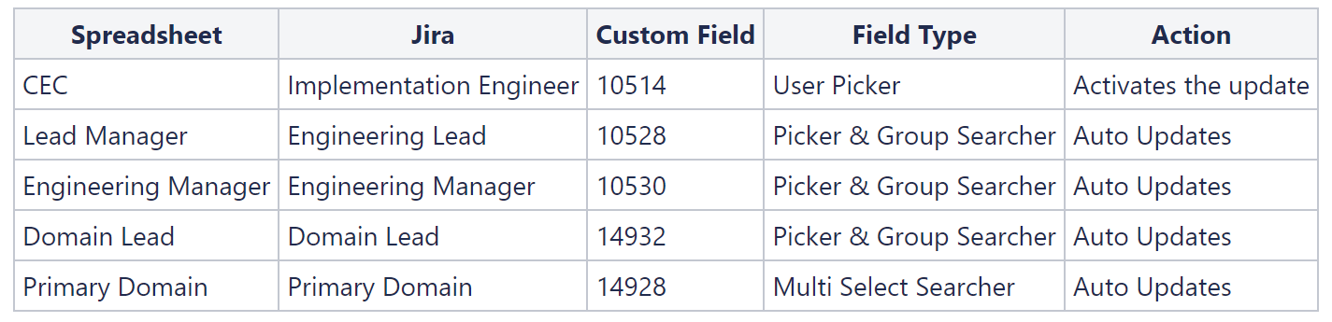
CATC CEC/Engineering Lead Lookup Listener Update
Problem Statement: Automate changing the Domain Lead and Primary Domain in a CATC issue when the Implementation Engineer is changed
Avoids having to manually look up who the Domain Lead/Primary Domain of the Implementation Engineer are and manually change these fields in their respective issues

Slide 7
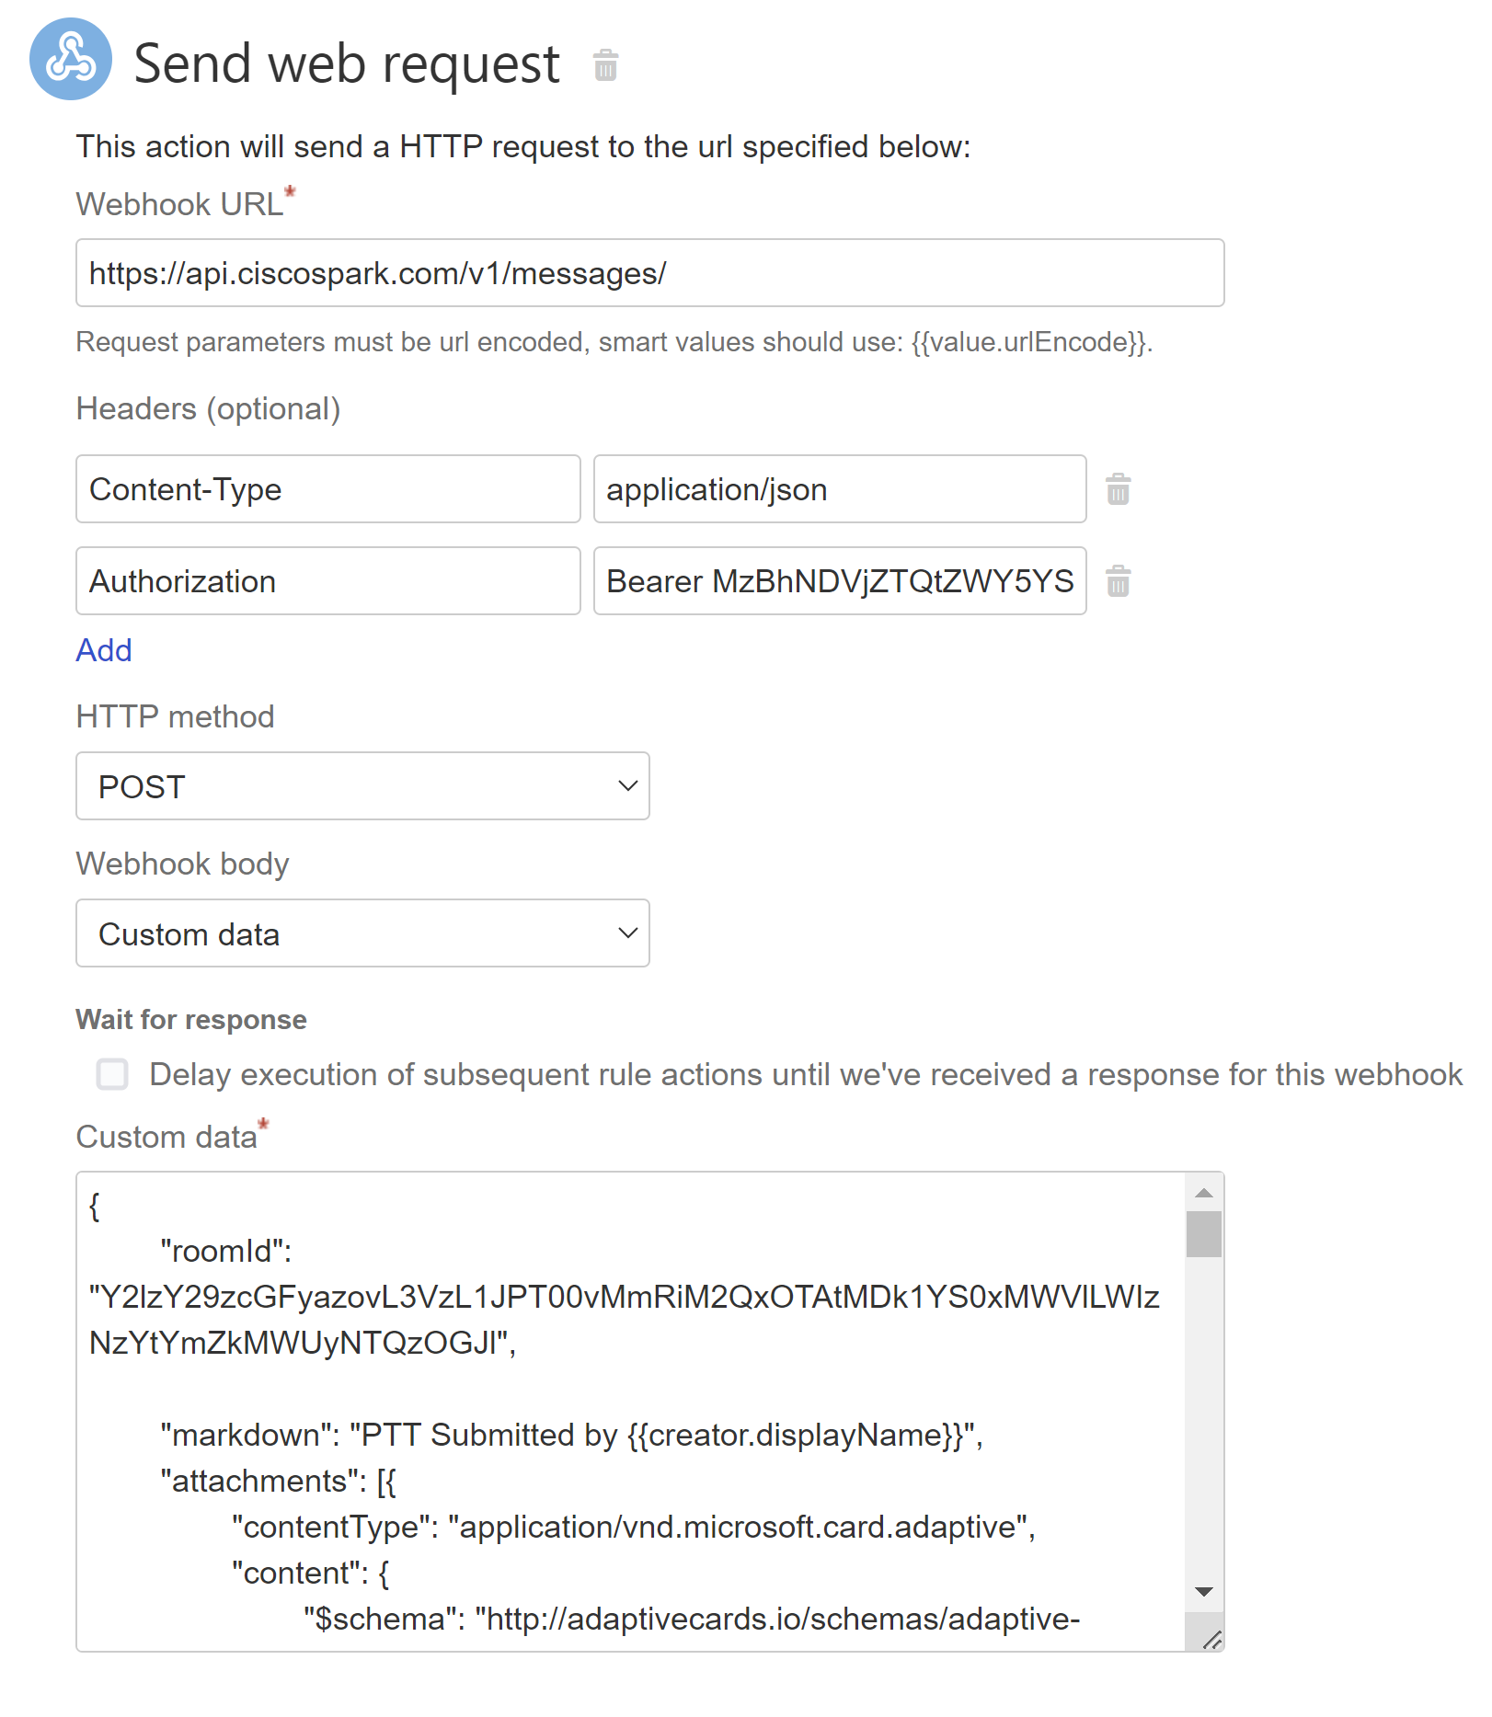
XSRF Token for PTT Notification Webhook
Problem Statement: Find a way to store a variable and use it as a smart value later. This will be used to alleviate an XSRF token issue in the following automation rule (currently active in the dev ATB project)
Challenges with Automation Rules:
Entity Properties Useless
Create Variable Didn’t Exist
Custom Field Values:
Doesn’t save until after automation finishes
Unsafe; token value can be accessed by others
Instead of utilizing automation actions, the automation rule will only run one script that sends a POST request after the creation of the issue.
Automation script useful in avoiding confusion on what token users are missing and also making it just a bit faster/less annoying to access the voting screen

Slide 8

Change Status Reason Prediction Model
Problem Statement:
Six different types of change status reasons after network change is made.
Can we predict the change status of a network change before work begins on it?
Create a multi-modal machine learning model to determine this.

Slide 9
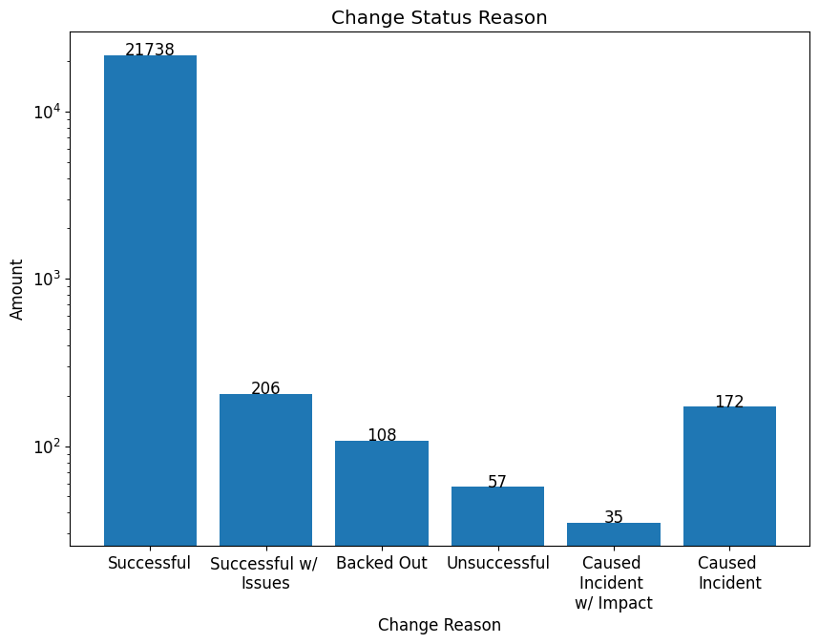
Explanatory Data Analysis
Number of Rows with Vendor = Cisco Engineering: 22316
Change Status Reasons:
Successful
Successful with Issues
Backed Out
Unsuccessful
Caused Incident
Caused Incident with Impact
For the sake of developing an accurate model, Successful with Issues and Backed Out were removed when developing model

Slide 10
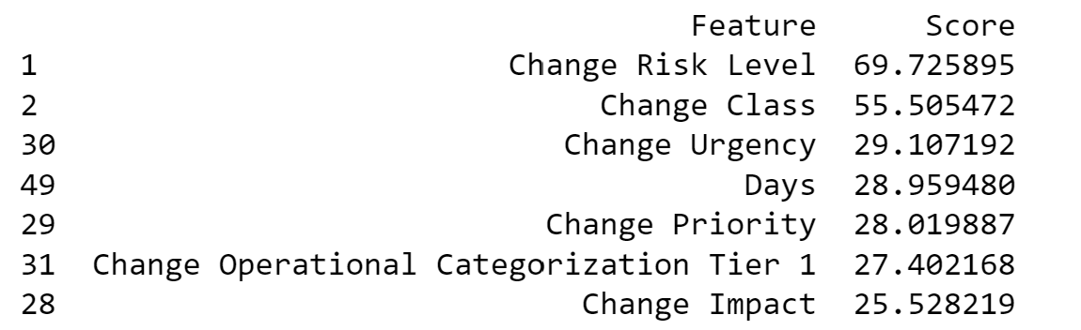
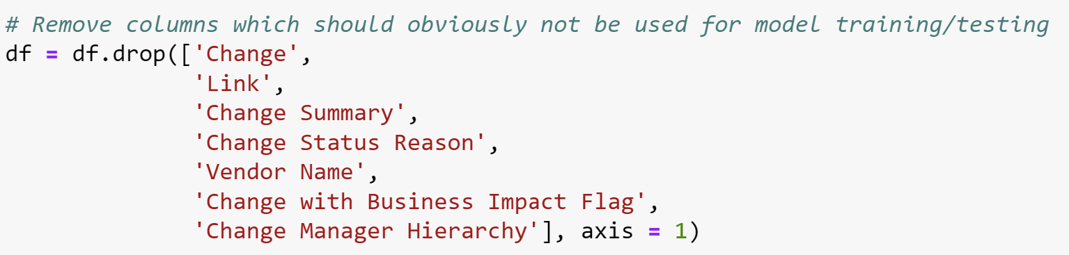
Data Preprocessing
Filled in columns that have null values
Removed columns which should obviously not be used for model training/testing data
Enumerate all categorical variables before pushing data into a model
Run a feature selection function to see which independent variables are best to use for creating the model

Slide 11
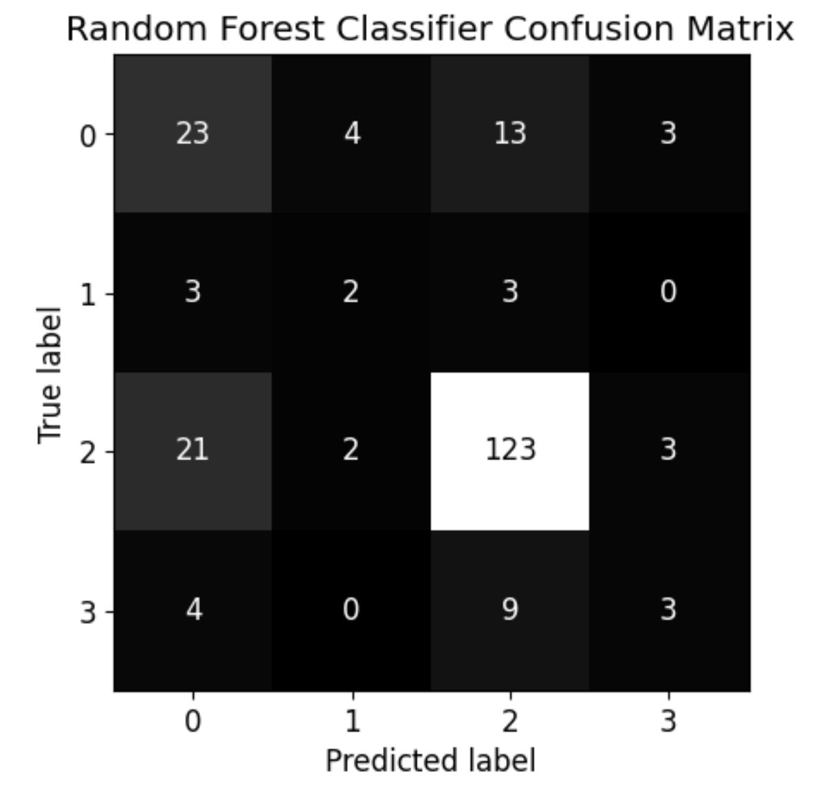
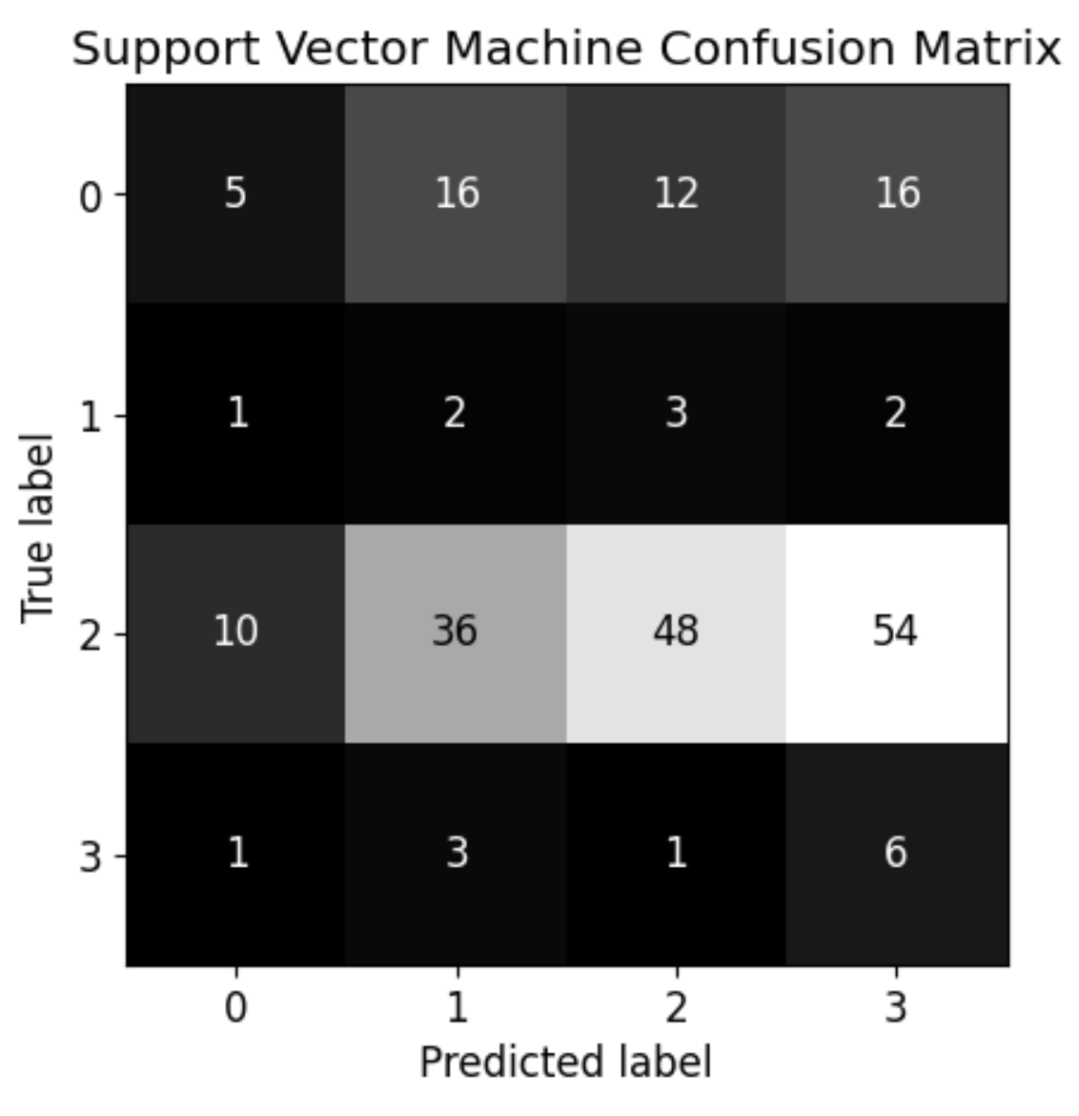
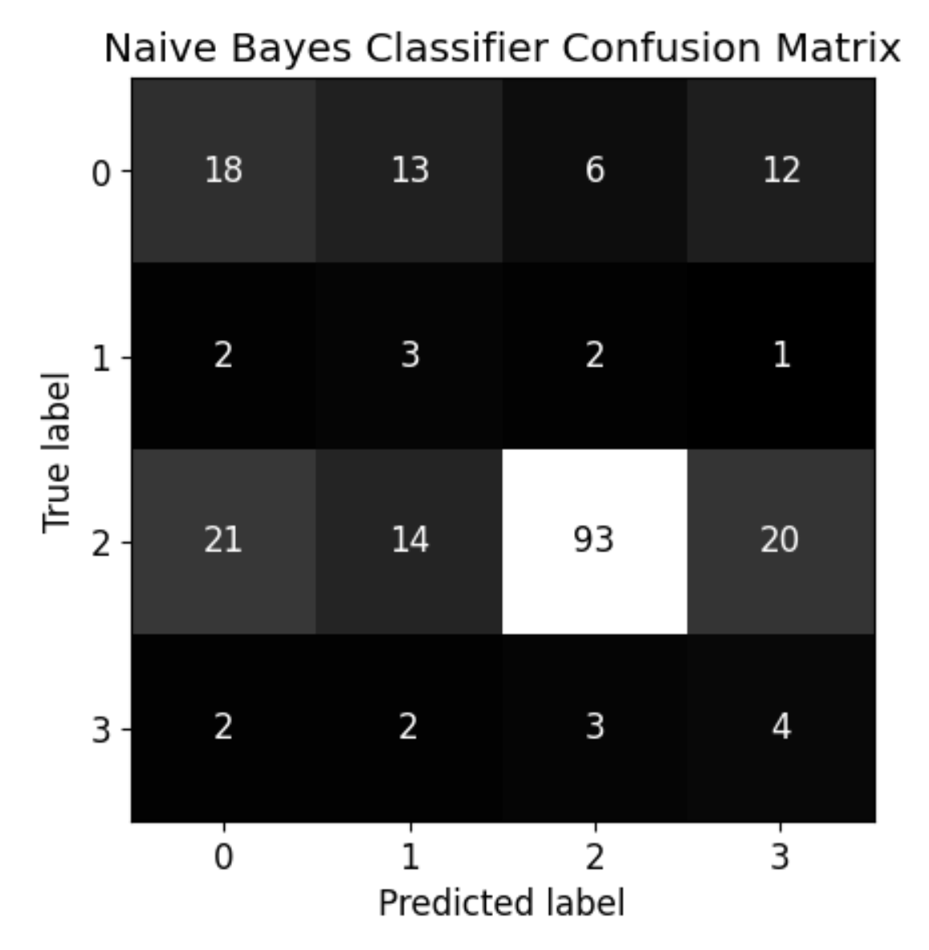
Classification Modeling
Split data into training/testing data (test size = 0.25)
Use SMOTE (Synthetic Minority Oversampling Technique Model) for oversampling issues in the data
Created three different models
Chose Random Forest Classifier

Slide 12
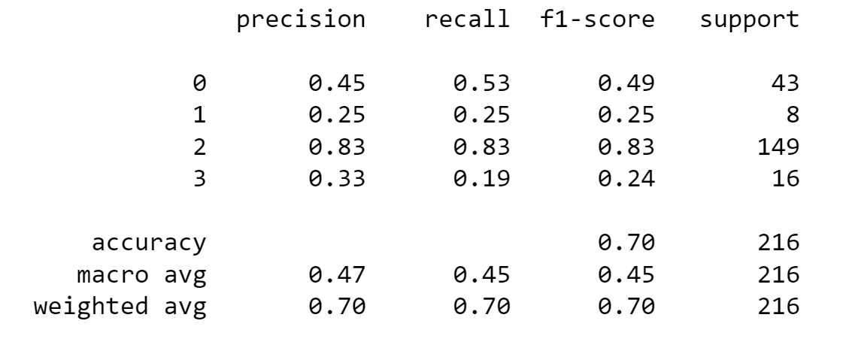
Results Explanation
Precision: # true positives / total # positive predictions
Recall: # true positives / total # actual positive instances in database
F1-Score: Harmonic mean of precision and recall
Support: # occurrences of each class
Accuracy: # correct predictions / total # of predictions
Macro Avg: Unweighted avg of precision, recall, and F1-score across all classes
Weighted Avg: Avg of precision, recall, and F1-score across all classes, weighted by # of samples in each class

Slide 13
Important Variables…
Change Reason Status – Enriched | Change Risk Level | Change Class | Change Urgency | Change Priority | Change Impact | Change Operational Categorization Tier 1 | Change Operational Categorization Tier 3
Successful | Risk Level 2 | Normal | 4-Low | Low | 4-Minor/Localized | Configure | Device
Unsuccessful | Risk Level 4 | Normal | 4-Low | Low | 4-Minor/Localized | Configure | Device
Caused Incident | Risk Level 4 | Normal | 4-Low | Low | 1-Extensive/Widespread | Configure | Device
Caused Incident with Impact | Risk Level 4 | Normal | 1-Critical | Critical | 1-Extensive/Widespread | Upgrade | Hardware

Slide 14
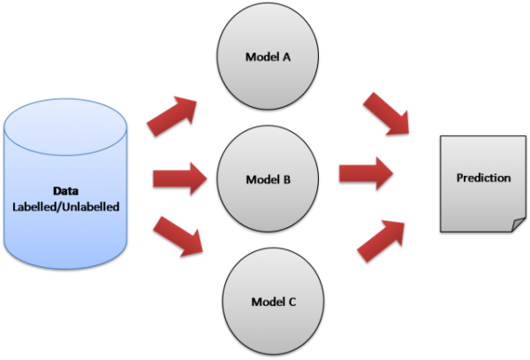
How to Improve the Model in the Future?
MORE DATA!!!
Additional information about issues that occur
Why issue occurred?
How issue happened?
More details on the network change itself.
Ensemble different models together for better results

Slide 15
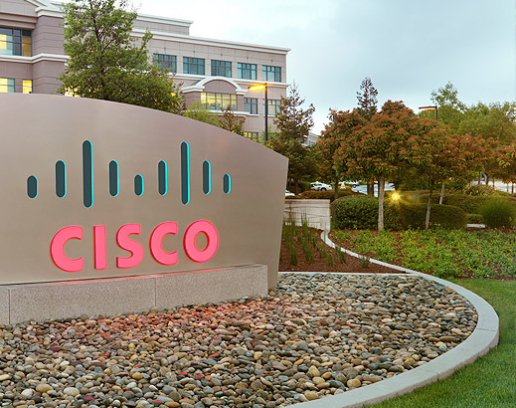
SPECIAL THANKS TO:
Stephen
Lauren
Joao
Eric
Connor
Shawn
Louis
Alvin
Anthony

Slide 16
THANK YOU FOR AN AWESOME SUMMER!!!

